Slide 1
FIVETHON - WEBINAR ON PYTHON
DAY 4
Function, Libraries, File Handling, Recursion

Slide 2
FUNCTIONS & FILE HANDLING
TOPICS TO BE COVERED:
FUNCTIONS:
FUNCTIONS
DEFINING A FUNCTION
FUNCTION CALL
DIFFERENCE BETWEEN CALL BY VALUE & CALL BY REFERENCE
TYPES OF FUNCTION
FUNCTION COMPOSITION
FRUITFUL FUNCTION
VOID FUNCTION
FUNCTION ARGUMENTS & IT’S TYPES
FILE HANDLING:
FILE PATH
ABSOLUTE PATH & RELATIVE PATH
OPENING & CLOSING FILES
WRITING & READING FILES
RENAMING & DELETING FILES

Slide 3
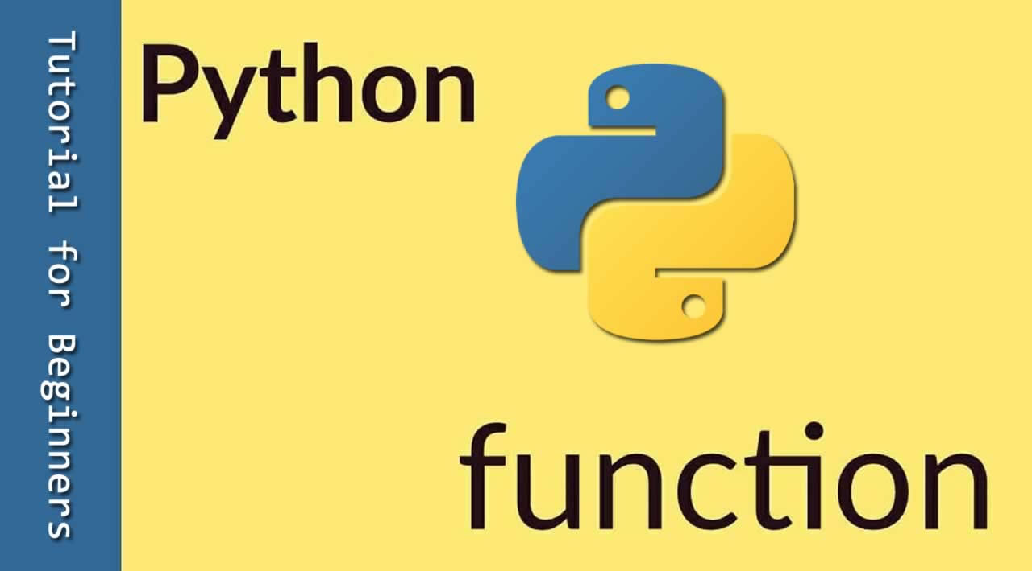
FUNCTIONS
A function is a block of organized and reusable program code that performs a single, specific and well-defined tasks.
Functions provide better modularity for your application and a high degree of code reusing.
All the statements in the function are executed and then the program control is passed to the statement following that one that called the function.
Functions calls only one function and also as many functions.

Slide 4
DEFINING A FUNCTION
You can define a functions to provide the required functionality.
Rules to define a function in python:
Function blocks begin with the keyword def followed by the function name and parantheses (())
Any Input parameters or arguments should be placed within these parantheses. You can also define parameters inside these paratheses.
The first statement of a function can be an optional statement-the documentation string of the function.(Docstring)
The code block within every element within every function starts with a colon(:) and is indented.

Slide 5
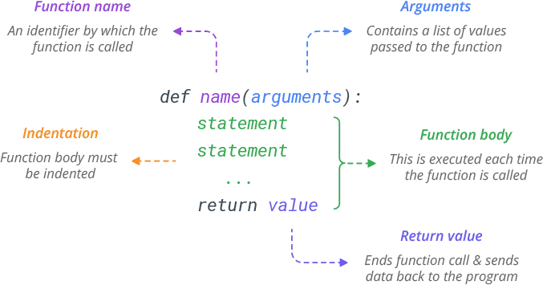
DEF FUNCTION
def functionname( parameters ):
"function_docstring"
function_suite
return [expression]
EXAMPLE:
def add(a,b):
total=a+b
return total

Slide 6
FUNCTION CALL
Defining a function means specifying its parameters that are expected,and set of instructions.
The function call statement invokes the function.
When a system is invoked, the program control jumps to the called function to execute the statement that as a part of function.
Once the called function is executed ,the program control passes back to the calling function.
Syntax:
function_name()
function_name(variable1,variable2,...)

Slide 7
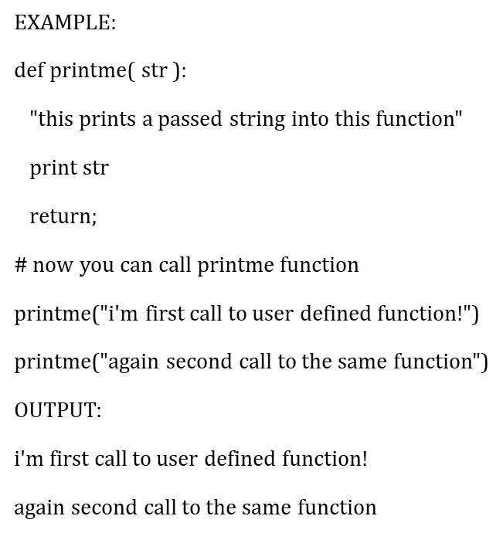
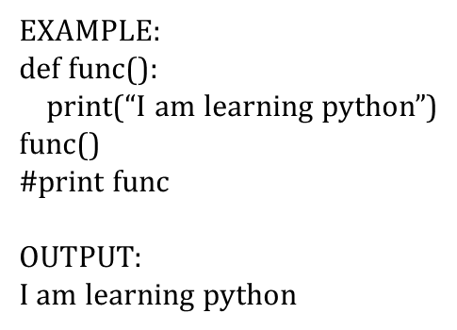
CALLING A FUNCTION

Slide 8
DIFFERENCE BETWEEN CALL BY VALUE AND CALL BY REFERENCE
In Call by value method original value is not modified whereas, in Call by reference method, the original value is modified.
In Call by value, a copy of the variable is passed whereas in Call by reference, a variable itself is passed.
In Call by value, actual and formal arguments will be created in different memory locations whereas in Call by reference, actual and formal arguments will be created in the same memory location.
Call by Value, variables are passed using a straightforward method whereas Call by Reference, pointers are required to store the address of variable

Slide 9
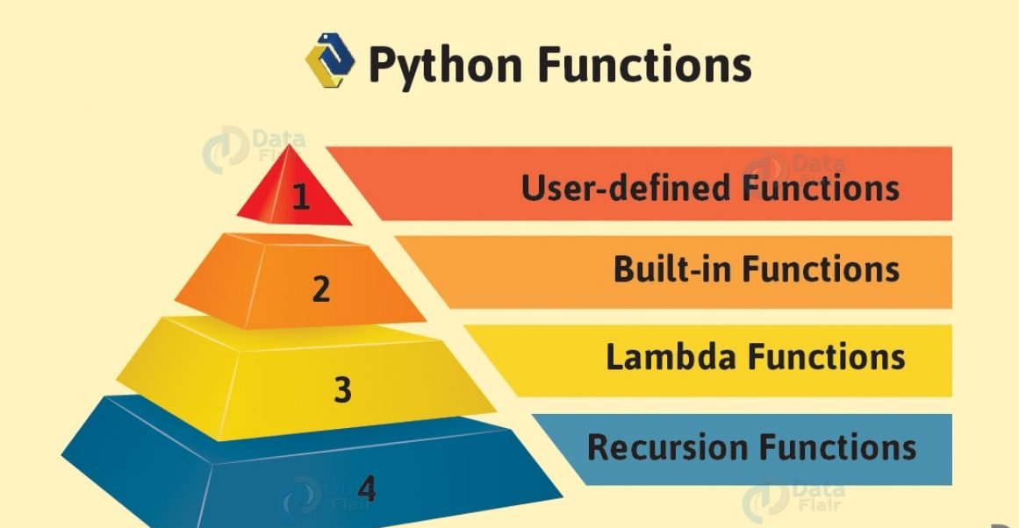
TYPES OF FUNCTIONS
USER DEFINED FUNCTION:
In Python, a user-defined function's declaration begins with the keyword def and followed by the function name.
SYNTAX:
def function_name(parameter_1, parameter_2, ...) :
statements
....

Slide 10
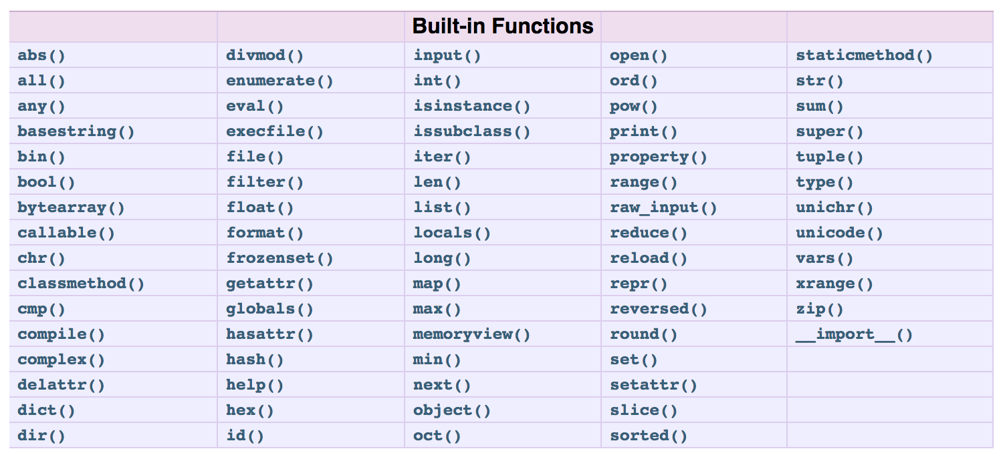
BUILT-IN FUNCTION: The python built-in functions are defined as the functions whose functionality is pre-defined in python. The python interpreter has several functions that are always present for use. These functions are known as built-in functions. There are several built-in functions. EXAMPLE:

Slide 11
LAMBDA FUNCTION: In Python, a lambda function is a single-line function declared with no name, which can have any number of arguments, but it can only have one expression. Such a function is capable of behaving similarly to a regular function declared using the Python's def keyword. SYNTAX: Difference between a normal def defined function and lambda function. This is a program that returns the cube of a given value: def cube(y): return y*y*y lambda_cube = lambda y: y*y*y # using the normally # defined function print(cube(5)) # using the lambda function print(lambda_cube(5)) OUTPUT:
lambda arguments : expression

Slide 12
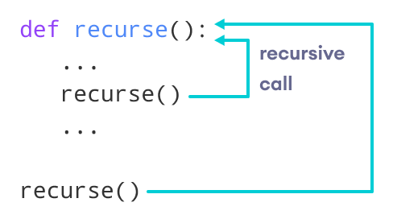
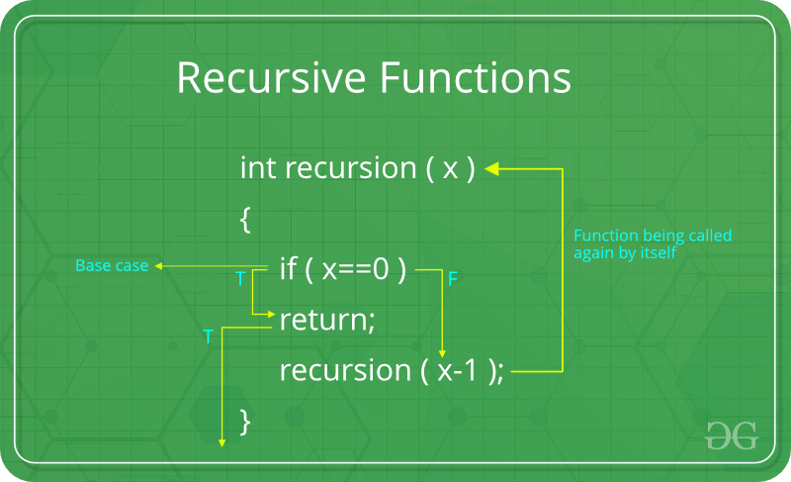
RECURSION FUNCTION:
Python also accepts function recursion, which means a defined function can call itself. Recursion is a common mathematical and programming concept. It means that a function calls itself. This has the benefit of meaning that you can loop through data to reach a result.(clean output)

Slide 13
FUNCTION COMPOSITION
Function composition combines two functions in such a way that the result of one function is passed as an argument to the other function.
It can be denoted as f(g(x)) where ,x is an argument to the function g() and the result g(x) is an argument to the function f().
The result of function composition is finally given as the result of function f().
EXAMPLE:
import functools
def square(x):
return(x**2)
def inc(x):
return(x+1)
inc_and_square = compose(square, inc)
res = inc_and_square(9)
print(res)
OUTPUT:
def compose2(f, g):
return lambda x: f(g(x))

Slide 14
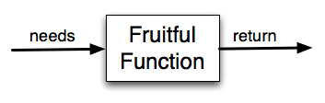
Fruitful function
A function that returns a value is called fruitful function.
This function returns a value that can utilized by the calling function for future processing.
It is not necessary for a fruitful function to return the value of one variable, the value can also return array or a vector.
In above example we have passed two values to the given function which then returns sum of that values to main function using return keyword.
def fun2(a,b):
return a+b
print(fun2(5,8))

Slide 15
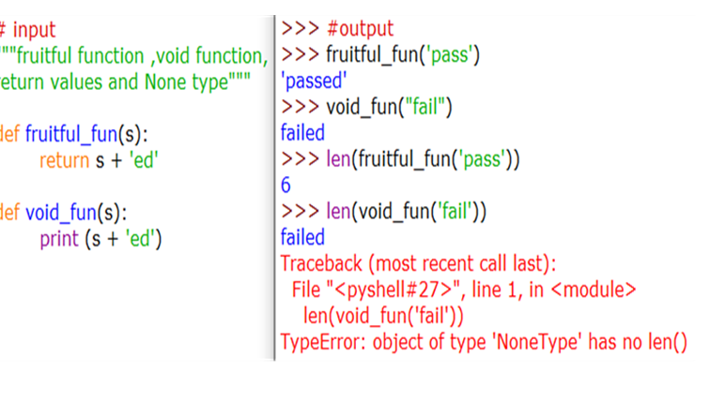
VOID FUNCTION
In Python, it is possible to compose a function without a return statement. Functions like this are called void, and they return None, Python's special object for "nothing”.

Slide 16
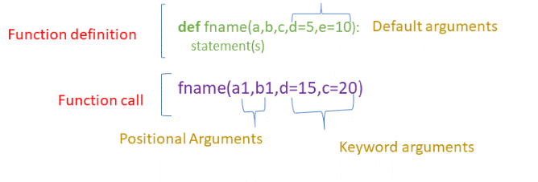
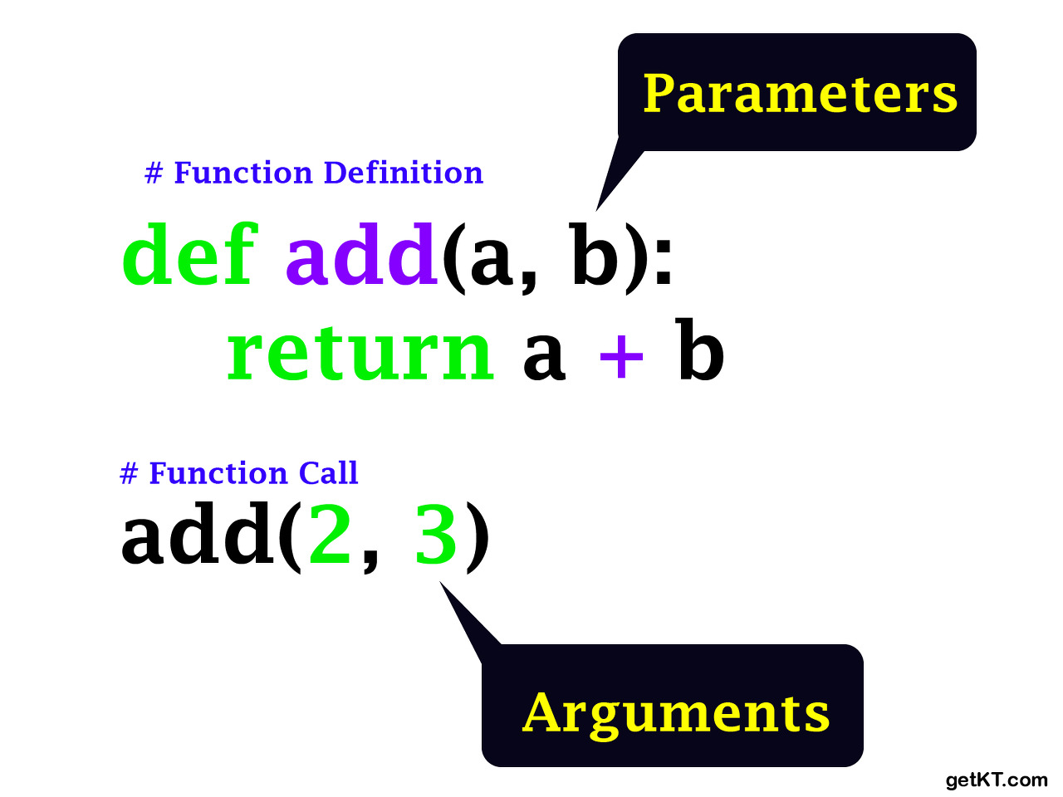
FUNCTION ARGUMENTS
The terms parameter and argument can be used for the same thing: information that are passed into a function.
From a function's perspective: A parameter is the variable listed inside the parentheses in the function definition.
An argument is the value that are sent to the function when it is called.

Slide 17
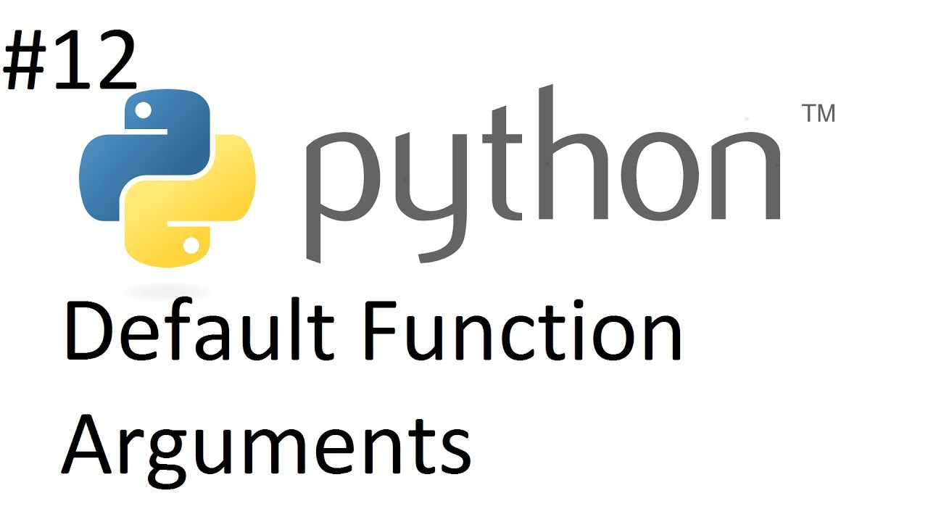
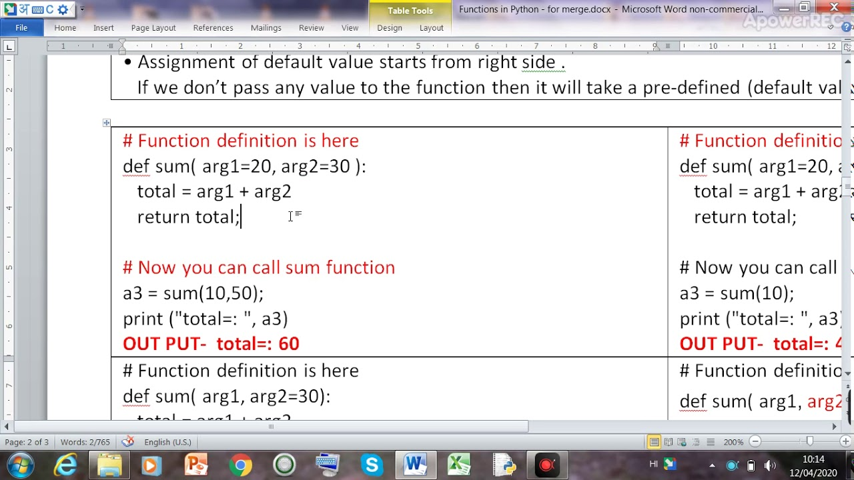
Types of function arguments
DEFAULT ARGUMENTS:
Python Program arguments can have default values. We assign a default value to an argument using the assignment operator in python(=).When we call a function without a value for an argument, its default value (as mentioned) is used.

Slide 18
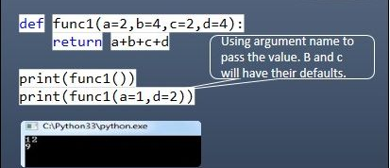
KEYWORD ARGUMENTS: Keyword arguments when used in function calls, helps the function to identify the arguments by the parameter name. There are two cases for keyword arguments. They are: first, if you skip arguments. Second, if the function calls you change the order of parameters. in both the cases mentioned above ,python interpreter uses a keywords provided in the function call to match the values with parameters. EXAMPLE:

Slide 19
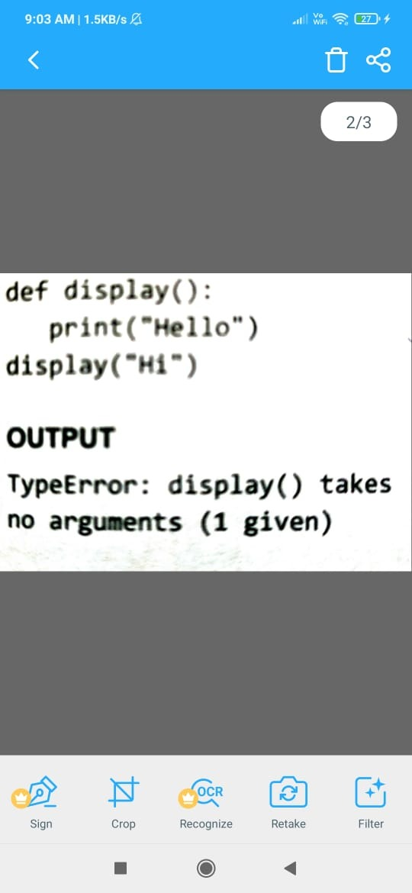
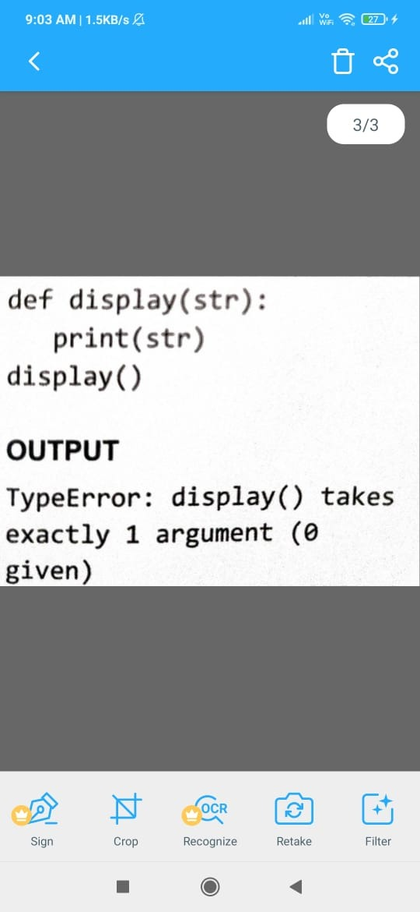
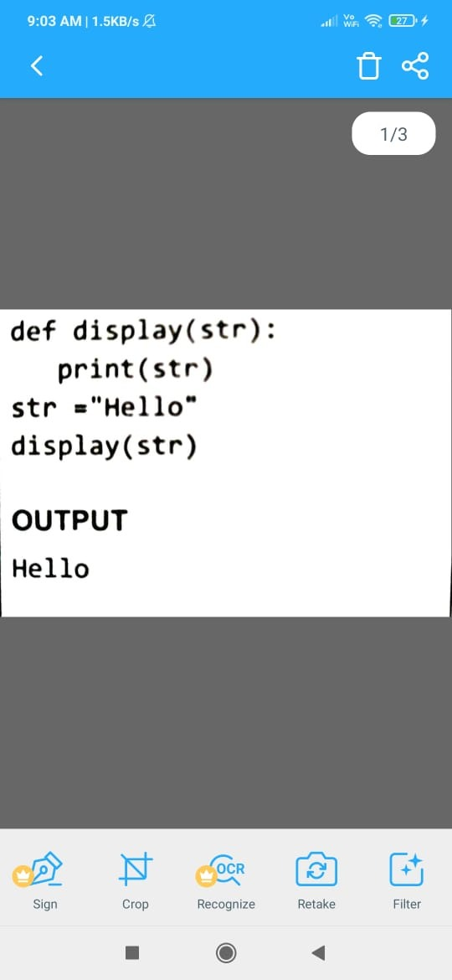
REQUIRED ARGUMENTS: In the required arguments, the arguments are passed to a function in correct positional order.This argument is also called as positional arguments. Also the number of arguments in the calling function should exact match with the number of arguments specified in the function definition. EXAMPLE: Just observe the output, in this argument the function displays the string only when number and type of arguments in the function call matches with the specified in the function definition.

Slide 20
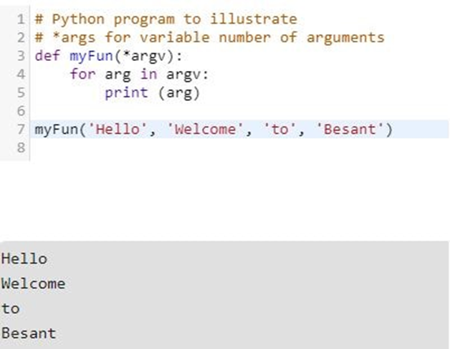
VARIABLE-LENGTH ARGUMENTS: You may need to process a function for more arguments than you specified while defining the function. These arguments are called variable-length arguments and are not named in the function definition, unlike required and default arguments. When we use arbitrary arguments or variable-length arguments,then the function definition uses an asterisk(*) before a parameter name. SYNTAX:
def functionname([arg1,arg2,….] *var_args_tuples):
function statement
return[expressions]

Slide 21
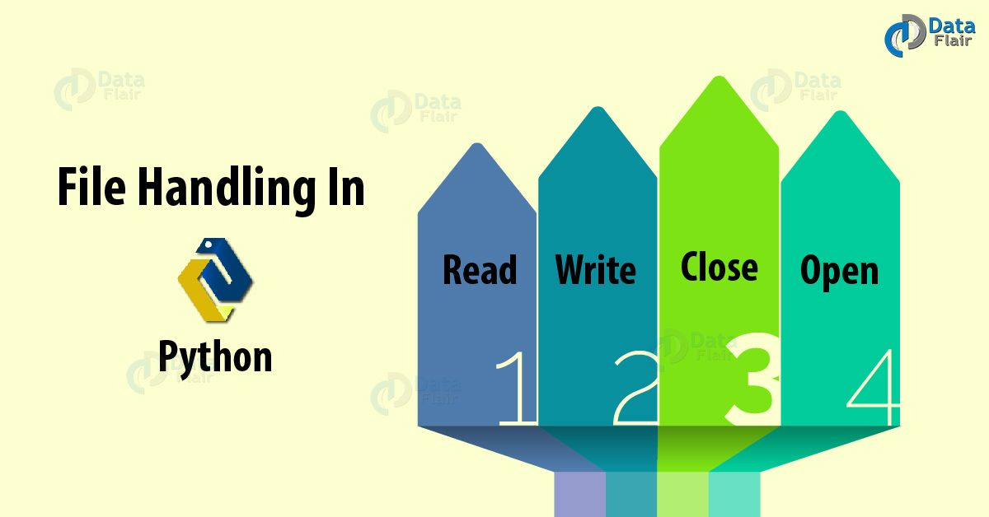
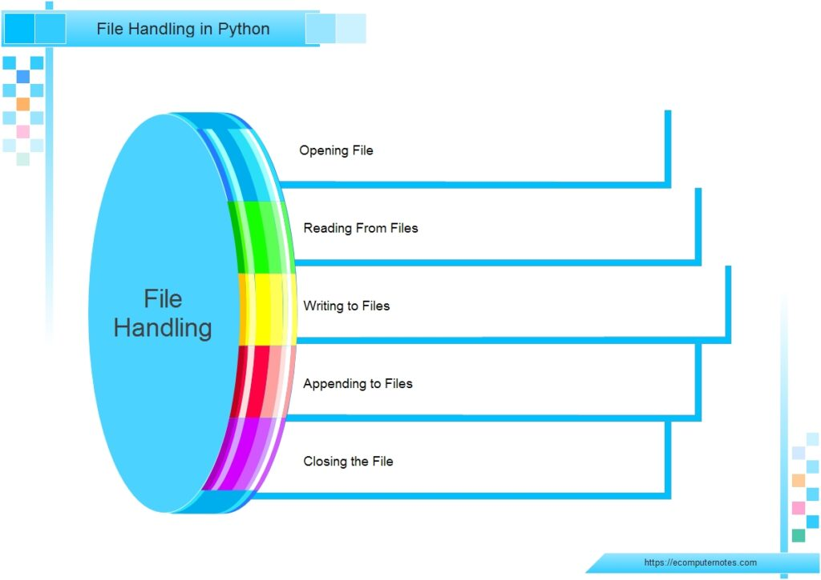
FILE HANDLING
File is a named location on the system storage which records data for later access.
It enables persistent storage in a non-volatile memory i.e. Hard disk.
In Python, file processing takes place in the following order. Open a file that returns a file handle.

Slide 22
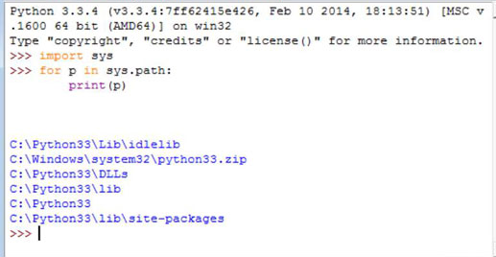
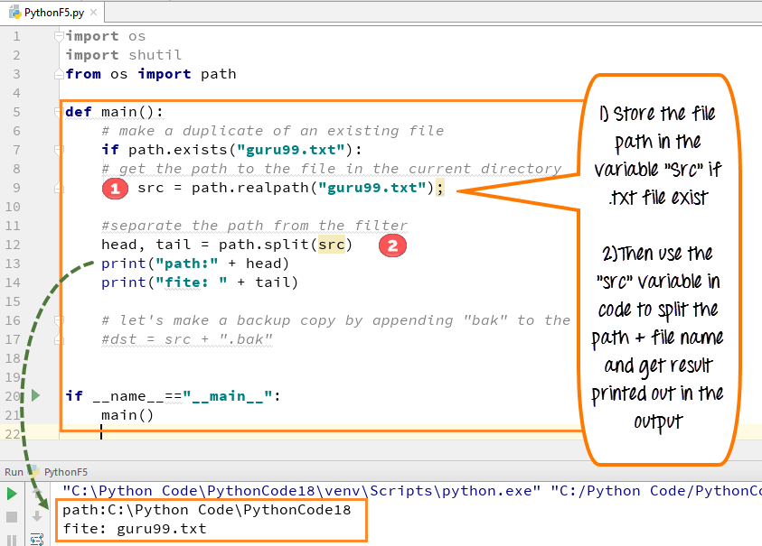
FILE PATH
Every file is identified by its path that begins from the root node or the root folder.
In windows, c:\(also known as c drive) is the root folder but you can also have a path that starts from other drives likes d:\,e:\ etc.
The file path is also known as pathname.

Slide 23
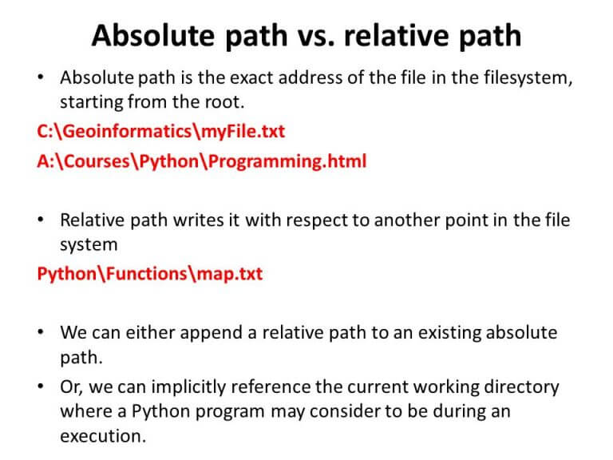
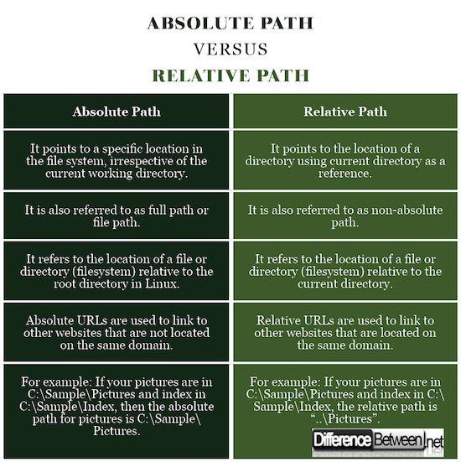
ABSOLUTE PATH & RELATIVE PATH

Slide 24
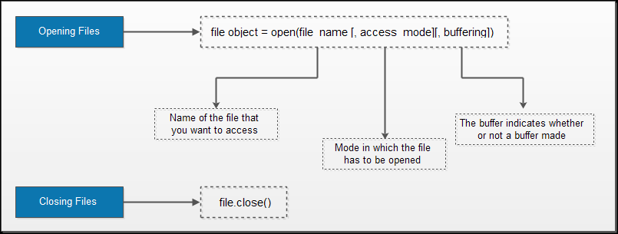
OPENING & CLOSING FILES
open() function:
Before reading or writing a file,you must first open a file using python’s built-in open() function.This function creates a file object,which will be used to invoke methods associated with it.
SYNTAX:

Slide 25
close() function: The close() method as the name suggests is used to close the file object.Once a file object is closed,you cannot further read from or write into the file associated with the file object.Although,python automatically closes a file when the reference object of a file is reassigned to another file. SYNTAX:

Slide 26
WRITING AND READING FILES
write() method:
The write() method is used to write a string to an already opened file.Of course this string may include numbers,special characters or other symbols.While writing data to a file,you must remember that the write() method do not add a newline character(‘\n’) to the end of a string.
SYNTAX: EXAMPLE:
fileObj.write(string);
file=open(“File1.txt”,”w”)
file.write(“hello all,hope you are enjoying python”)
file.close()
print(“Data written.”)
OUTPUT:
Data written.

Slide 27
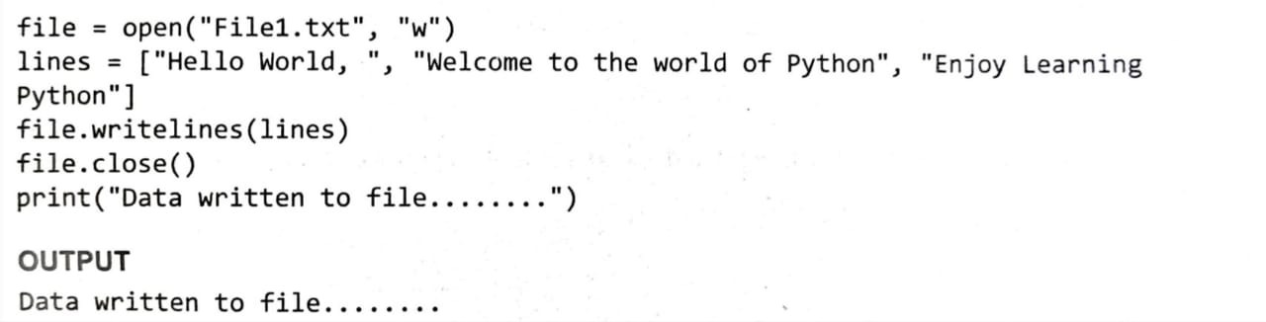
writelines() method: writelines() method is used to write a list of strings. EXAMPLE:

Slide 28
read() method: read() method is used to read a string from an already opened file.as said before ,the string can include alphabets,numbers or other symbols. SYNTAX: EXAMPLE:
fileObj.read([count])
file=open(“File1.txt”, ”r”)
print(file.read(7))
file.close()
OUTPUT:
welcome

Slide 29
readline() method: readline() method is ued to read a single line from the file.The method returns an empty string when the end of the file has been reached. EXAMPLE:
file=open(“File1.txt”, ”r”)
print(“First line: “, file.readline())
print(“Second line: “, file.readline())
file.close()
OUTPUT:
First line: Hi All,
Second line: Hope you are enjoying learning Python

Slide 30
readlines() method: readlines() method is used to real all the lines in the file. EXAMPLE:
file=open(“File1.txt”, “r”)
print(file.readlines())
file.close()
OUTPUT:
[‘hello all,\r\n’, ‘\r\n’, ‘hope you are enjoying learning python\r\n’ ,’we have tried to cover every point in detail to avoid confusion\r\n’, ‘\r\n’, ‘happy reading\r\n’]

Slide 31
RENAMING & DELETING FILES
rename() method:
The rename() method takes two arguments,the current filename and the new filename.Its doesn’t return any values.
SYNTAX: EXAMPLE:
os.name(old_file_name, new_file_name)
import os
os.rename(“file1txt”, “maneesh.txt”)
print(“file renamed”)
OUTPUT:
file renamed

Slide 32
remove() method: This method is used to delete files.This method takes a filename(name of the file to be deleted) as a argument and delete the files. SYNTAX: EXAMPLE:
os.remove(file name)
import os
os.remove(“file1.txt”)
print(“file deleted”)
output:
file deleted

Slide 33


Python library

Slide 34

Introduction

Slide 35
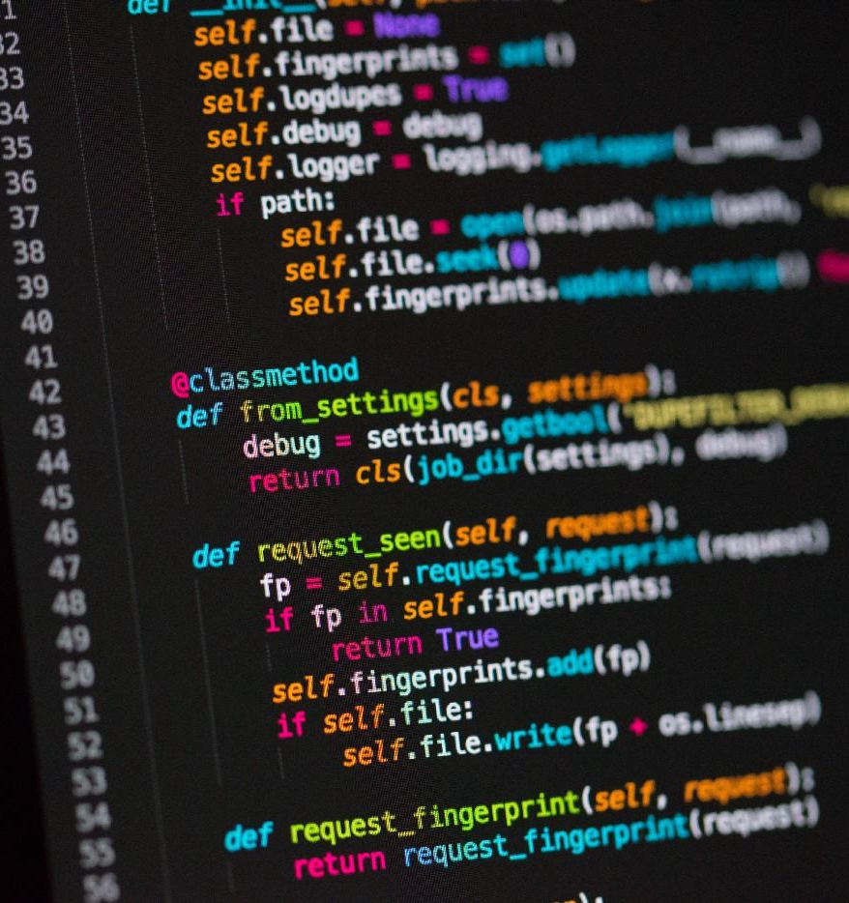
What is Python Lib
A Python library is a reusable chunk of code that you may want to include in your programs/ projects.

Slide 36

Games
freegames
chess

Slide 37
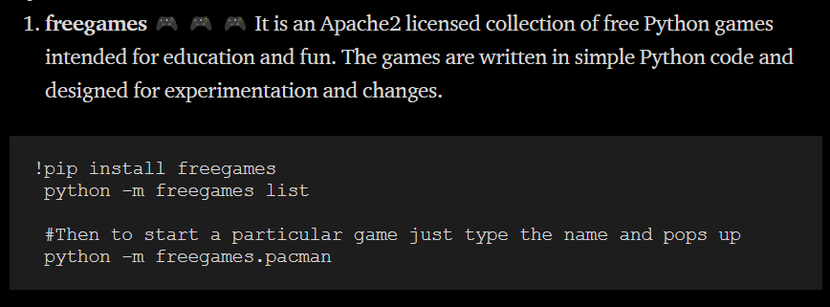
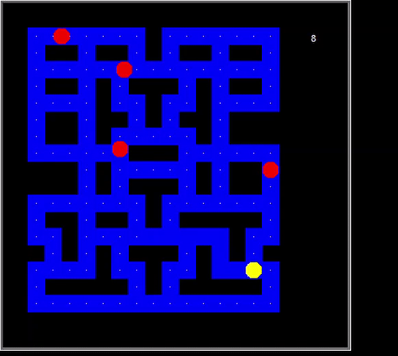
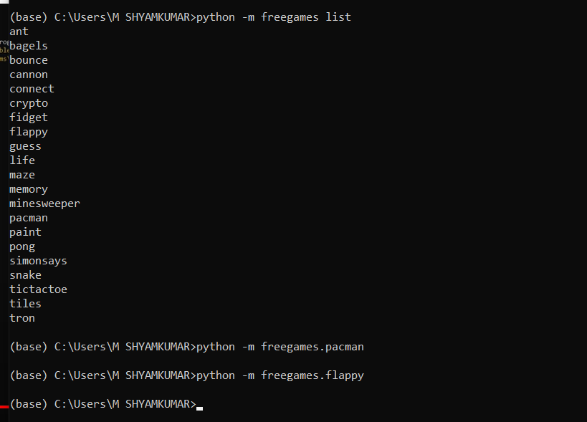

Slide 38
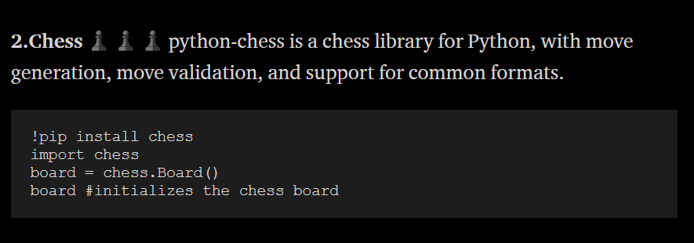
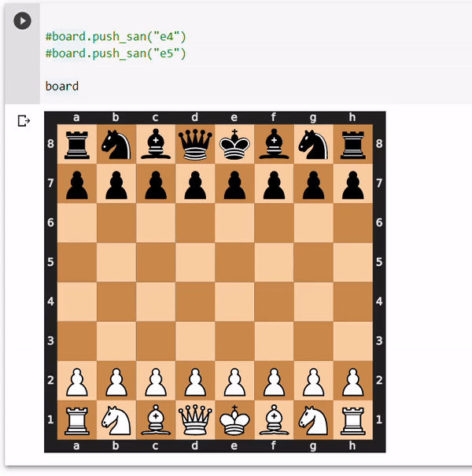


Slide 39


Design
Turtle

Slide 40
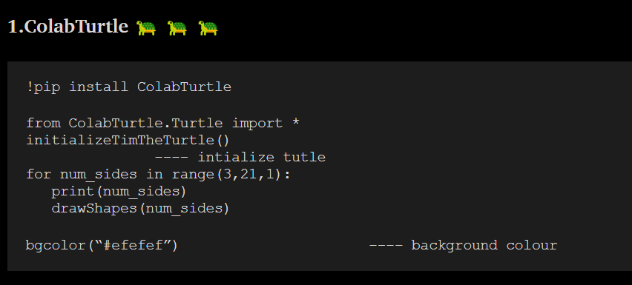

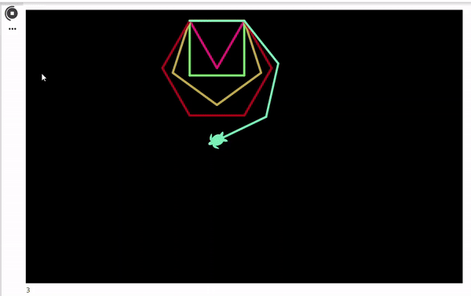

Slide 41

NLP

Slide 42
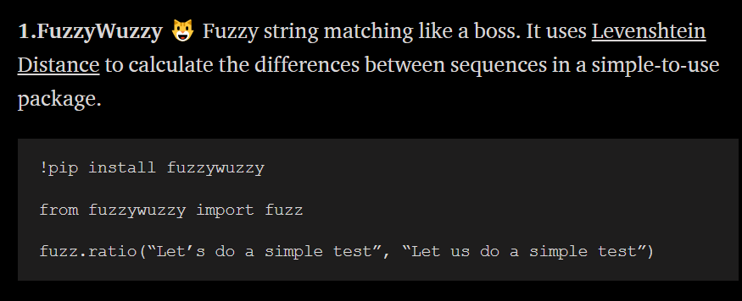

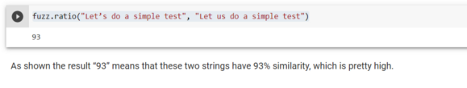

Slide 43
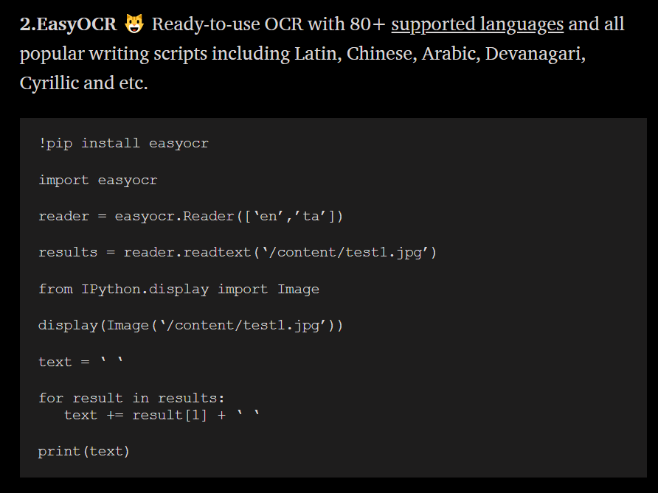


Slide 44

Fake
Faker

Slide 45
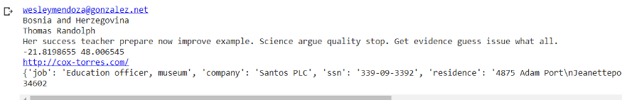
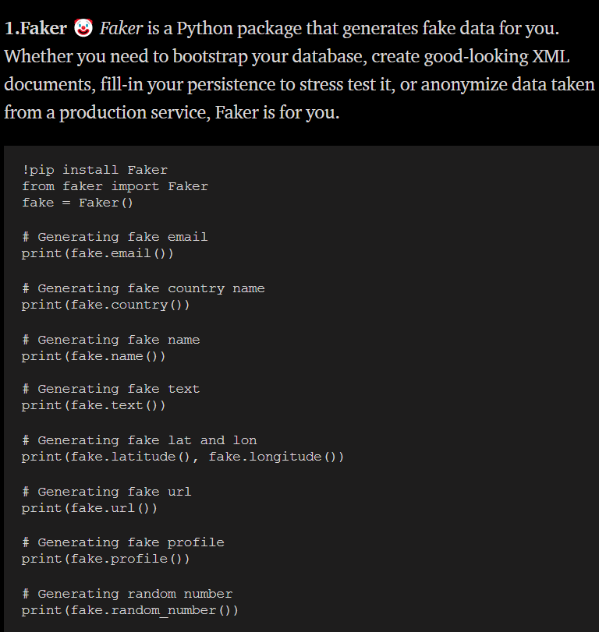


Slide 46

News:
GoogleNews
Wikipedia

Slide 47

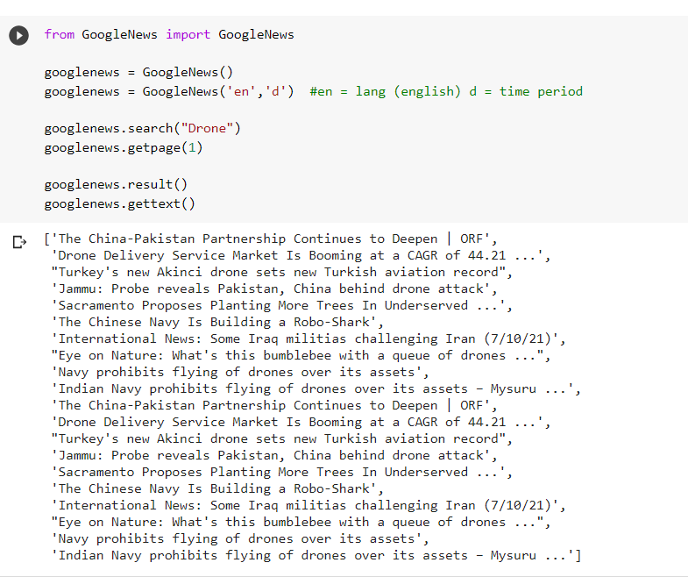


Slide 48
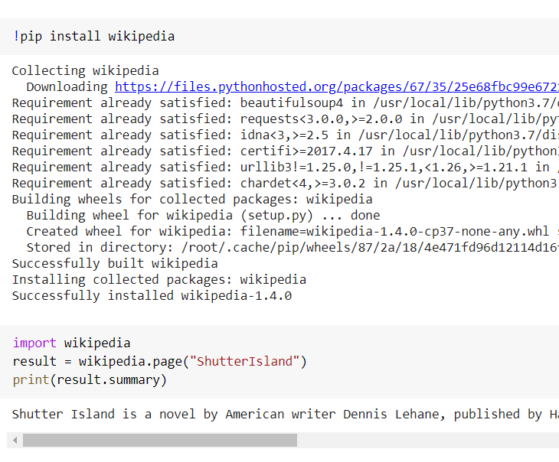

Wikepedia:
Wikipedia is by far the world’s largest encyclopedia; it is the largest, most comprehensive, and most accessible compilation of knowledge to exist in the history of the human race. Wikipedia is a Python library that makes it easy to access and parse data from Wikipedia. Search Wikipedia, get article summaries, get data like links and images from a page, and more.

Slide 49
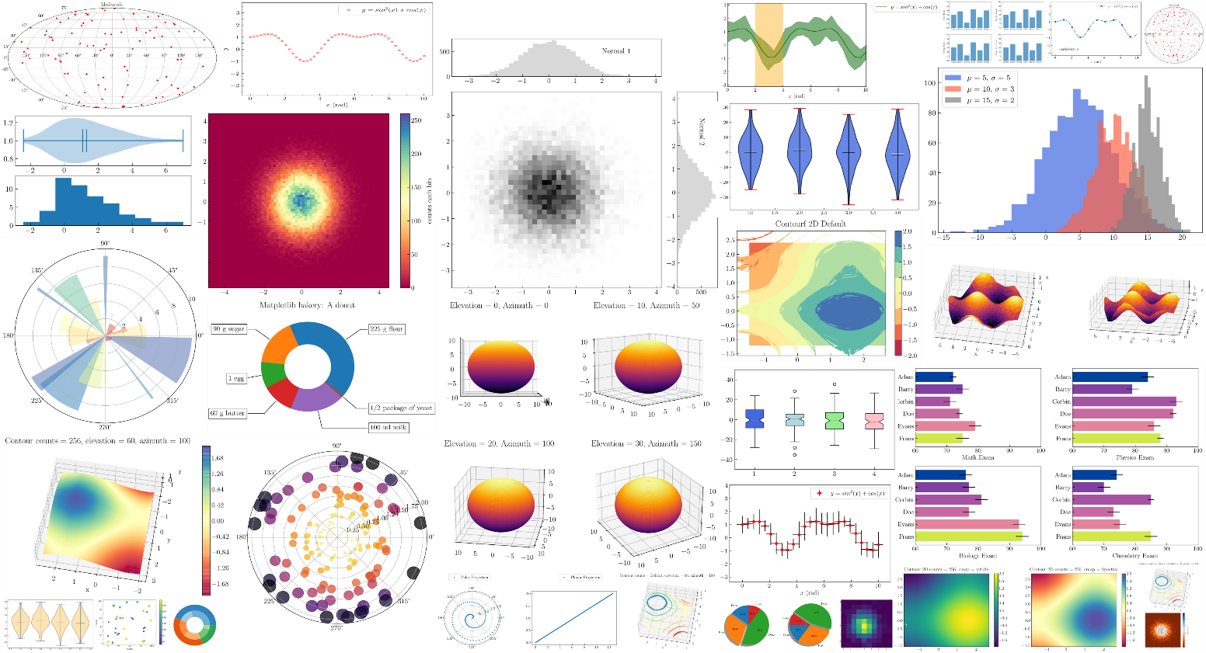

Matplotlib
Matplotlib is a plotting library for the Python programming language and its numerical mathematics extension NumPy.

Slide 50
